Slide 1
G
B
the
REACT 16
THEORY
What’s new in React 16
Marianna Etelson
March, 2018

Slide 2
React 16.x Releases
16.0.0 - September 26, 2017
16.1.0 - November 9, 2017
16.1.1 - November 13, 2017
16.2.0 - Latest release (improved support for fragments)
16.3.0 (alpha.2) - New Context API

Slide 3
React 16 JS Environment Requirements
collections types Map and Set
Use global polyfill in your bundled app such a core-js or babel-polyfill for older browsers and devices support (e.g IE < 11)
requestAnimationFrame (even in test environments)
use the raf package to shim requestAnimationFrame

Slide 4
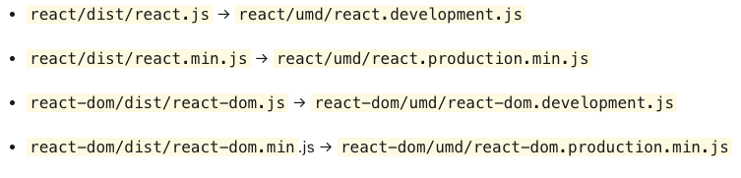
Packaging
No react/lib/* and react-dom/lib/* anymore
Changing names and paths to the single-file
“If you previously relied on undocumented React internals, and they don’t work anymore, let us know about your specific case in a new issue, and we’ll try to figure out a migration strategy for you”

Slide 5

REDUCED FILE SIZE
React v16.0 is actually smaller
32% size decrease compared to the previous 15.6.1 version

Slide 6

WHAT IS THE BIG BANG OF REACT 16?
Complete rewrite of the React Core Algorithm

Slide 7

NEW CORE ARCHITECTURE
Why Core Algorithm Rewrite?
Asynchronous rendering
Efficient error handling using error boundaries
Longstanding features :
Fragments
Returning text from render
Simple, non-complex ways to write custom renderers
Scheduling of rendering work subtrees

Slide 8
REACT FIBER
Compatible rewrite of React Core Algorithm
Incremental rendering
Split interruptible rendering work into chunks and spread it over multiple frames
Pause work and come back to it later
Reuse previously completed work
And abort work

Slide 9
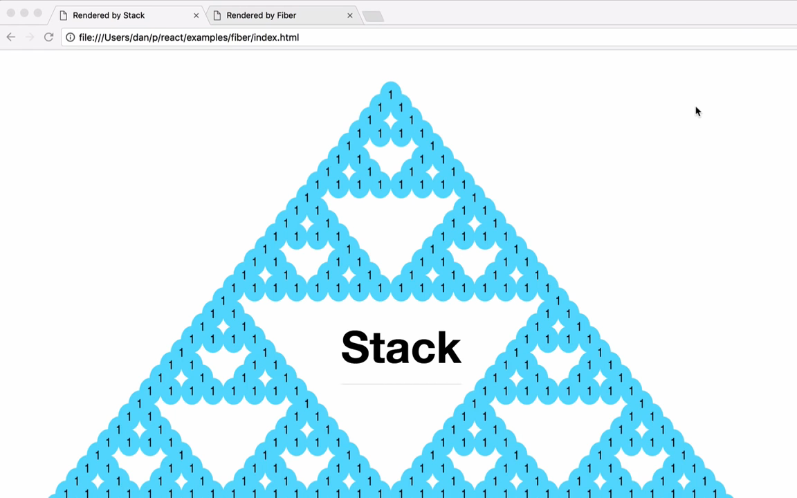
REACT FIBER
Task Scheduling: allows smooth rendering of the UI
Notes:
React 16 is the first version of React built on top of a new core architecture, which is named “Fiber”. The new features in React v16.0 i.e. error boundaries, fragments, portals and async rendering have been made possible due to Fiber
Let's talk a bit about React Fiber. As I mentioned earlier, React Fiber has been in development for a while
React Fiber is a complete, backward compatible rewrite of the ReactJS core which enables sophisticated scheduling of rendering work. It is a reimplementation of ReactJS's core algorithm. The goal of React Fiber is to increase its suitability for app development in sections like gestures, animation, and layouts.
The goal of React Fiber is to enable incremental rendering—the ability to split rendering work into chunks and spread it out over multiple frames. In addition, the ability to pause, abort, or reuse work as new updates come in and the ability to assign priority to different types of updates.
React Fiber is a reimplementation of a stack frame specialized for ReactJS components. Each fiber can be thought of as a virtual stack frame where information from the frame is preserved in memory on the heap, and because the info is saved on the heap, you can control and play with the data structures and process the relevant information as needed.
React Fiber allows smooth rendering of the UI by pausing once in a while and checking for more important updates rather than waiting for all the changes to be propagated throughout the entirety of the component tree before updating the UI. The task scheduling ability of React Fiber makes this possible

Slide 10



REACT 16 FEATURES
Fragments & Strings
Breaking changes
Error Handling
New Context API (16.3.0)
Portals
No Redux or MobX to manage state!!!
Custom DOM attributes
Server Side Rendering
New Context API (16.3.0)
with Redux or MobX
Breaking changes

Slide 11
RESOURCES
React v16.0
React Fiber Architecture
React v16.2.0: Improved Support for Fragments
DOM Attributes in React 16
What’s New With Server-Side Rendering in React 16

Slide 12
THANK YOU
…and may the Fourth be with us…

